Slide 1


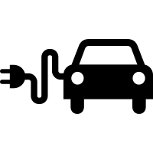










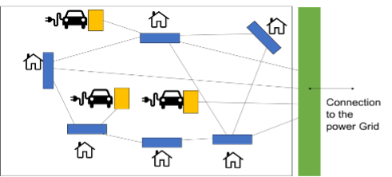
Coordination platform to ensure interaction between Grid Edge Devices
GED
GED (Grid Edge Device)
GED
GED
Coordination platform
Connection
to the
Power Grid
GED
Interactions between GEDs for :
– Exchanging electricity
– Peak shaving
– Gossip Learning
(algorithms)
Flow of information
GED
Flow of electricity

Slide 2
Coordination model to ensure interaction between Grid Edge Devices
GED
GED (Grid Edge Device)
GED
GED
Coordination model
Connection
to the
Power Grid
GED
Flow of information
Interactions between GEDs for :
– exchanging electricity
– peak shaving
– Gossip Learning
GED
Flow of electricity

Slide 3
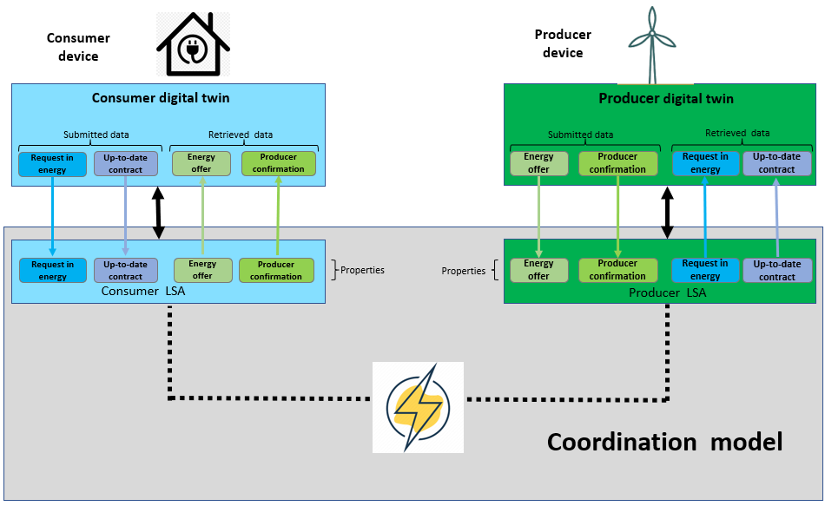
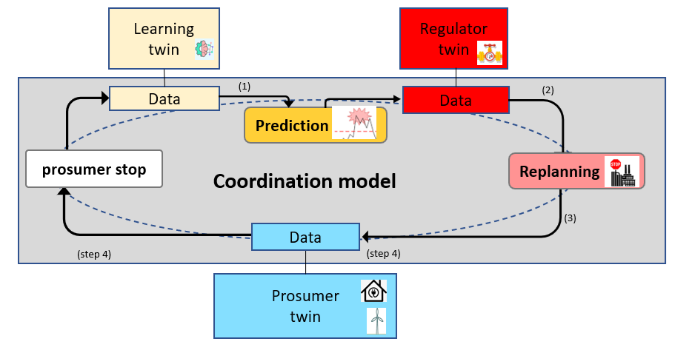
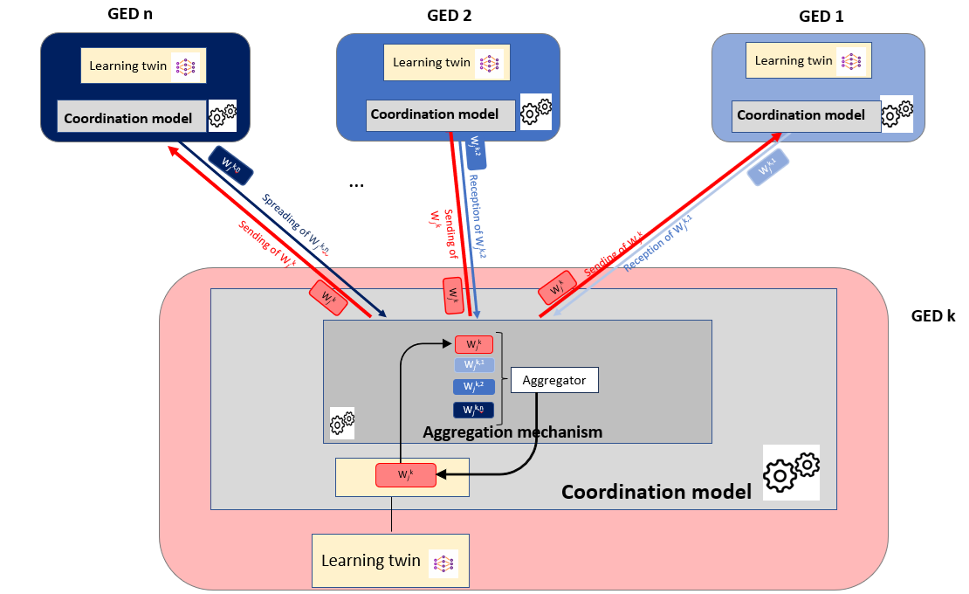
The 3 types of interaction
Exchanging energy
2. Peak shaving
3. Gossip Learning

Slide 4

Questions

Slide 5
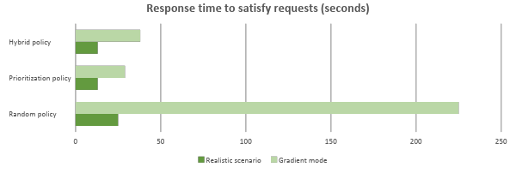
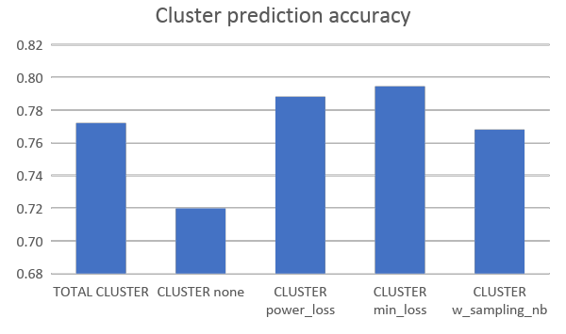
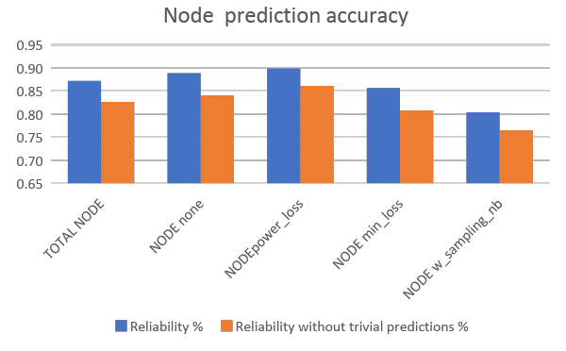
Coordination model: some results
Maximal response time to meet demands for electricity:
Prediction accuracy when using gossip learning:

Slide 6
Project status: done + ongoing
Item | State of progress
 | Defined | Implemented | Evaluated | Revised
Coordination model/platform
Digital twins producer, consumer, learning agent, regulator algorithms for establishing contracts
Light version of the coordination platform that can run on a Raspberry Pi device
Real-life scenarios using real data from “Les Vergers” Living Lab
Crisis scenarios (1) : over-production/consumption, urgent demand
Crisis scenarios (2) : tragedy of the common, Shortage
Integration of gossip based federated learning using the platform
Integration of social acceptance by design
 | not started |  | on going |  | completed

Slide 7
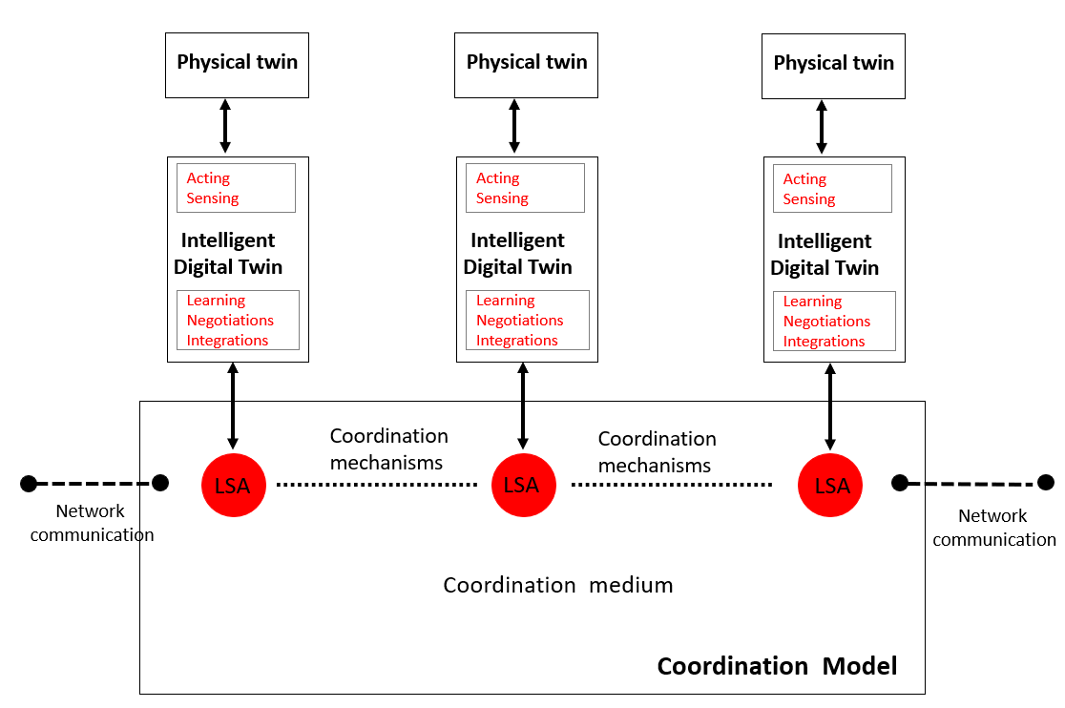
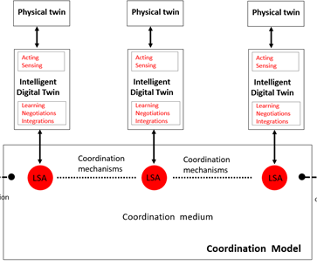
Method: coordination model and platform
Implementation of a coordination platform using:
digital twins,
shared virtual environment (tuple space)
coordination laws.

Slide 8
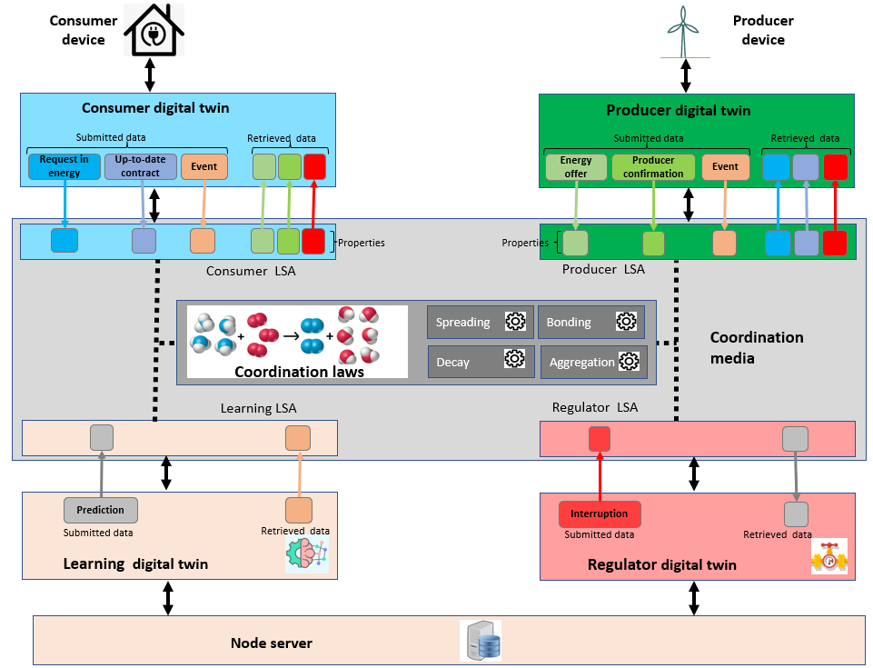
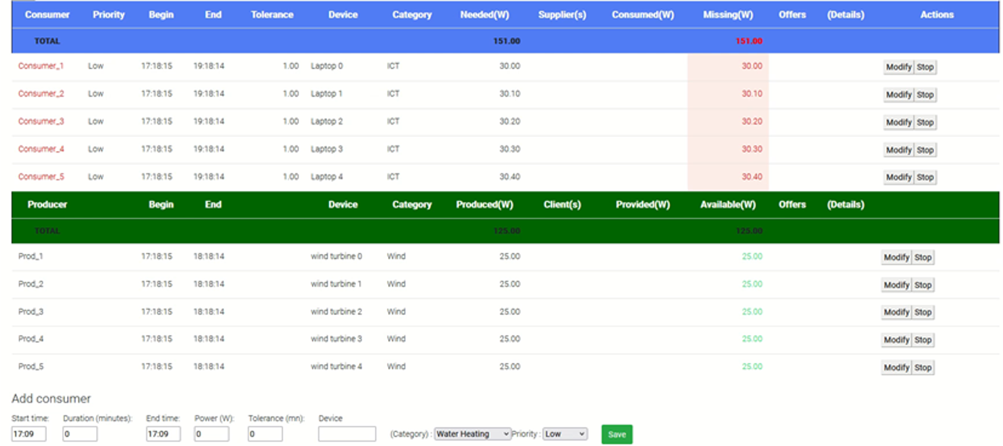
Method: Coordination platform and digital twins
Digital twins: agents' behaviours as
consumer
producer
learning agent
regulator
Agents act autonomously, adapt, organize, and make decisions according to the situation.
Dynamic self-adaptive generation of supply contracts between producers and consumers
Progress report, February 2024

Slide 9

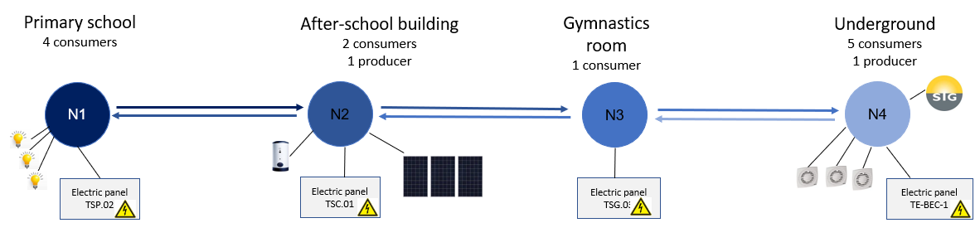
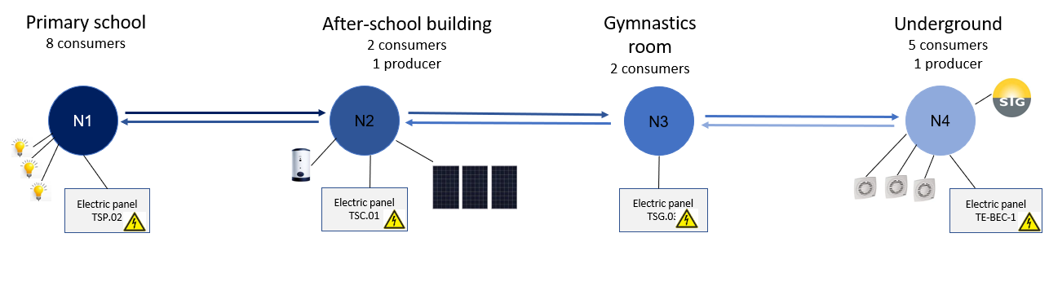
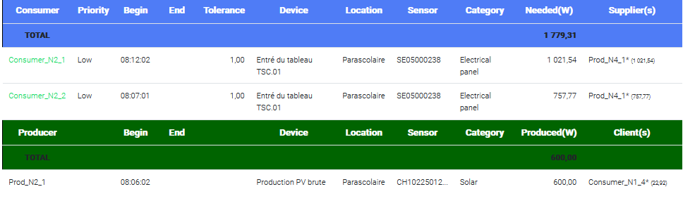
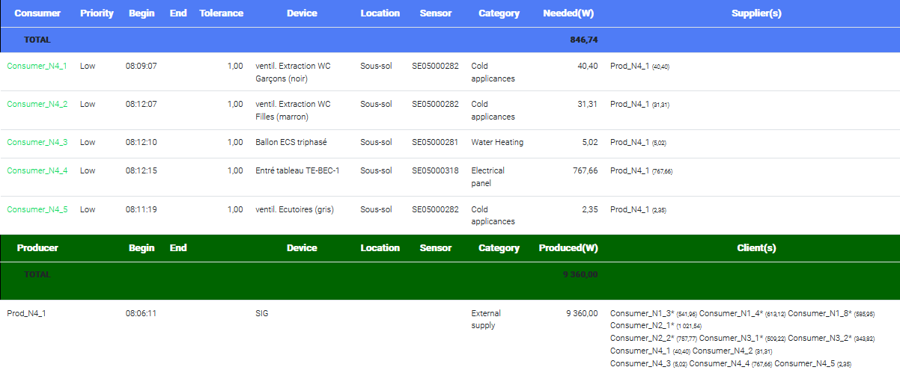
Tuning of the coordination platform to match with the living lab configuration
“Chain” topology with 4 nodes(1 or 2 neighbours by node)

Slide 10
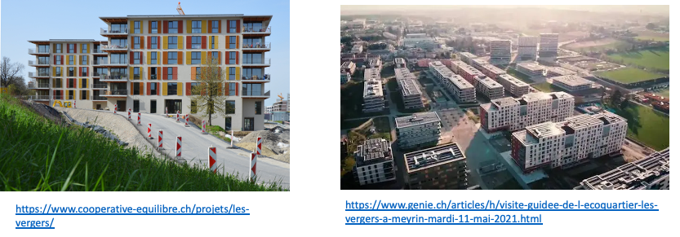
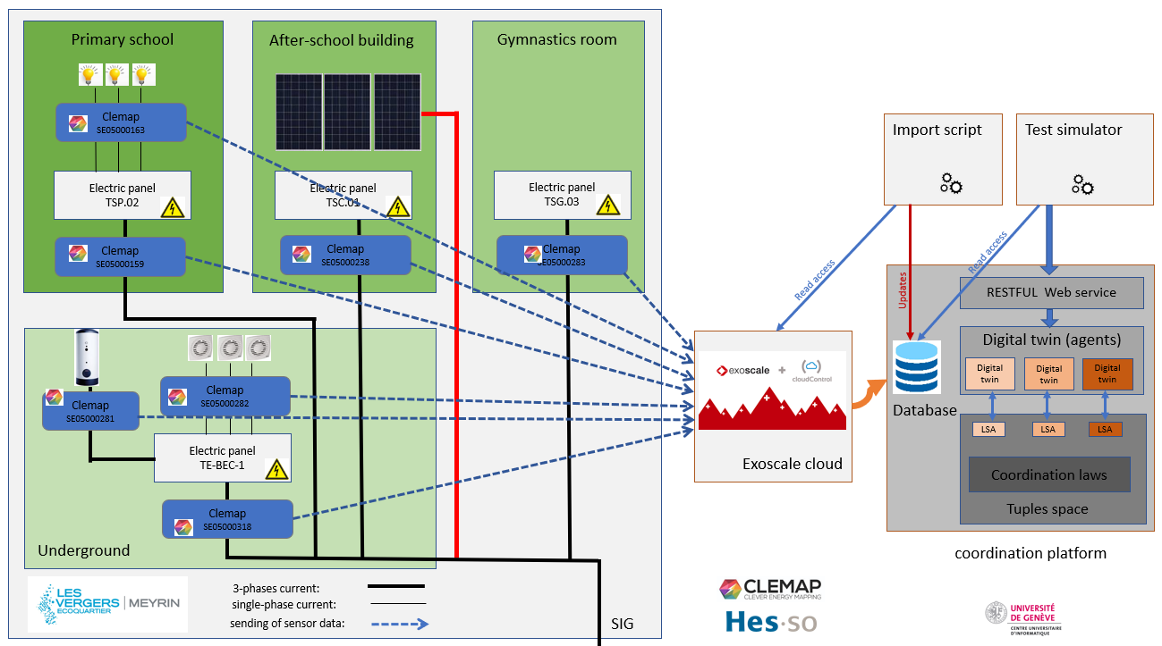
Tuning of the coordination platform to match with the living lab configuration
Power measurements by smart-meters.
Storage of measurement history.

Slide 11

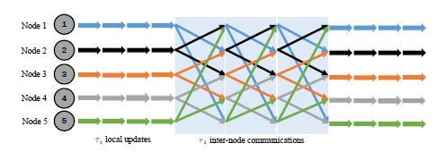
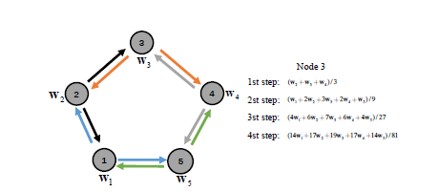
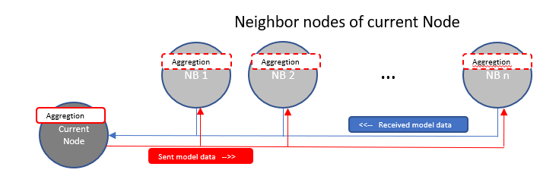
Integration of gossip based Federated Learning
Mechanism of Distributed Federated Learning framework:
Use of machine learning at each node level
Fully decentralised
Exchange of model data between nodes
Aggregation of model weights at each node (progressive aggregation)
Independent of Learning Model itself. (Markov chains and LSTM used in the experimentation)
Wei Liu, Li Chen, and Wenyi Zhang : Decentralized Federated Learning: Balancing
Communication and Computing Costs
Using of Gossip (aggregation + spreading).
Aggregator function defined in the service layer
(customized)
Progress report, February 2024

Slide 12
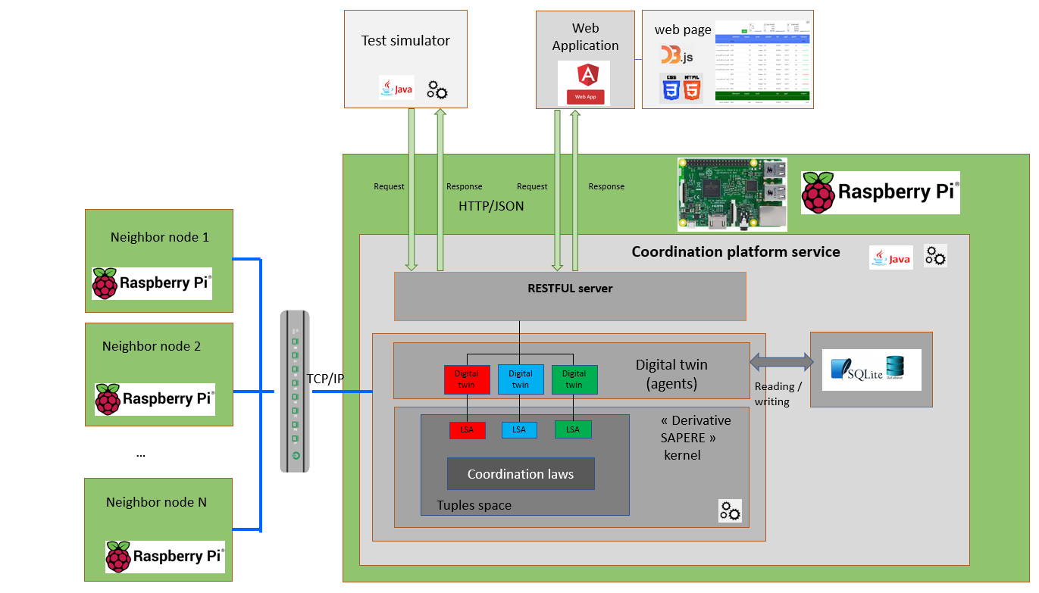
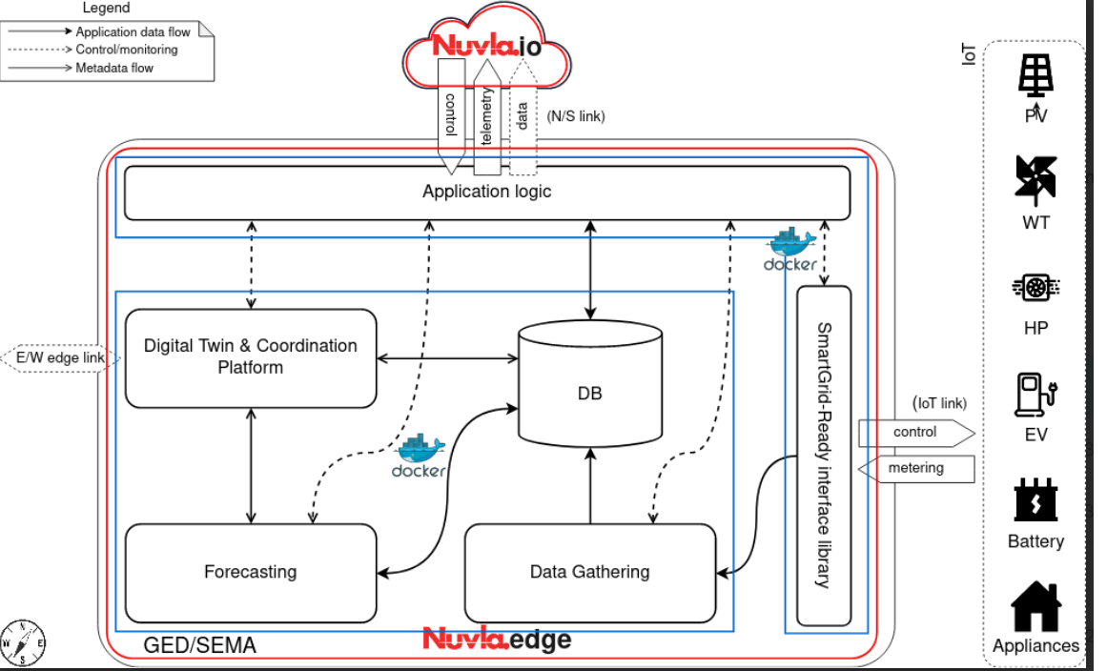

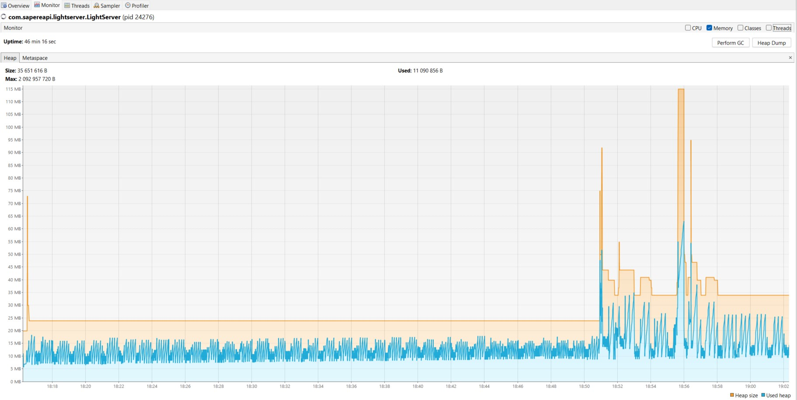


Adaption of the platform for Raspberry pi-3
Definition of the target architecture
Monitoring of memory consumption (Visual VM tool)
Deactivation of functionalities not used in a light environment (prediction)
Replacement of spring-boot server by a lighter REST server
Replacement of MariaDB & MongoDB by SQLite3
Building of docker image containing the coordination service jar file
Progress report, February 2024

Slide 13
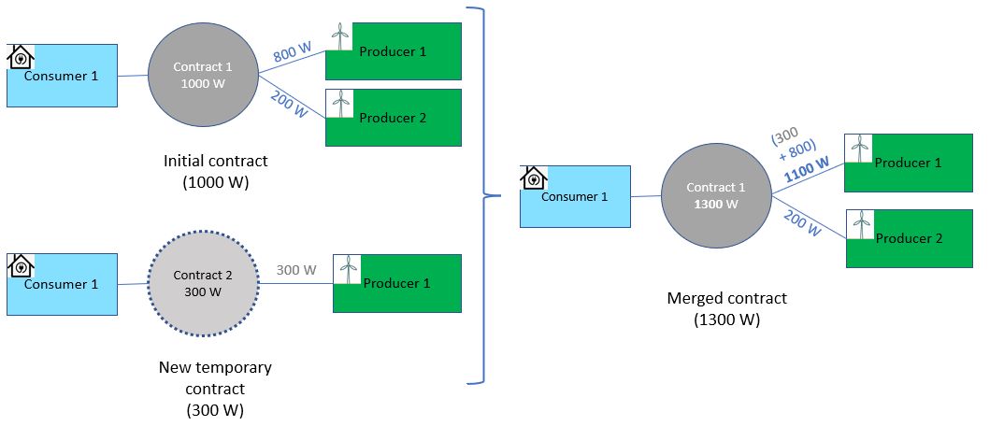
Improvement of the digital twins
Testing of the consumer/producer digital twins by using the data collected from Les Vergers.
Consideration of the fluctuation in demands
Use of a margin in a contract to absorb the power variation
Use of a second « transition contract » when the variation is more important.
Adaptation to meet a growing demand for electricity ( + 300 Watts)
Progress report, February 2024

Slide 14
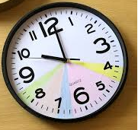

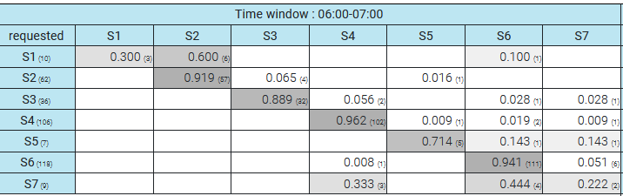
Learning model: use of Markov chains
State of the node
=> 6 variables: wattage demanded, produced, consumed, provided, missing and available
Definition of Markov states
Cutting of the variable space (time slots)
Recording the number of observations
Transition matrix
Progress report, February 2024
14

Slide 15
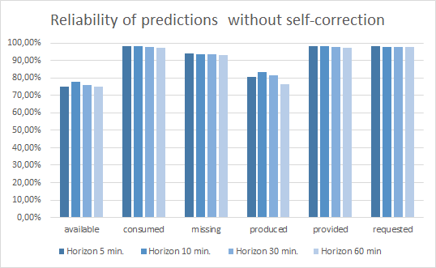
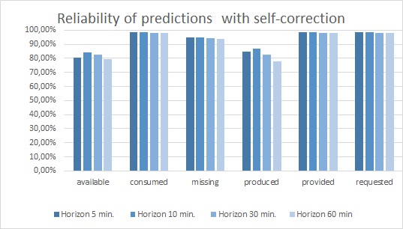
Improvement of the learning model
Training the model using data from Les Vergers
Evaluation of the model by comparing the predicted states with the actual state distribution
Generation of prediction statistics to better understand the difficulties encountered by the model.
Auto-correction mechanism executed by the model.
Progress report, February 2024

Slide 16
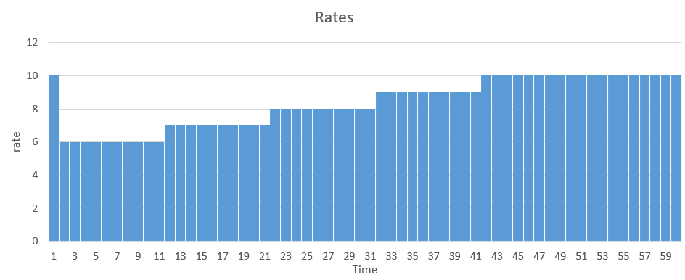
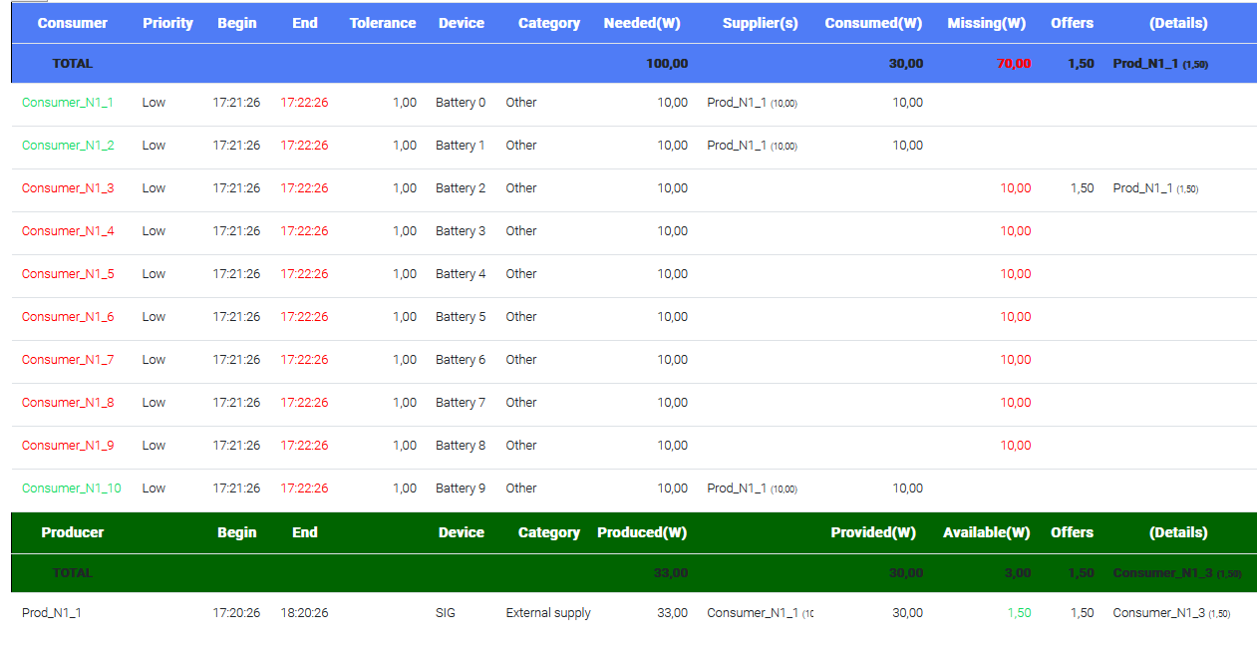
Scenario “Tragedy of the common” (ongoing)
Rates of electricity set by a producer :
Results :
10 demands at the same time (10 x 10 Watts) :
only 3/10 can be satisfied
33 Watts produced
Progress report, February 2024

